Slide 1

Unveiling Glitches: A Deep Dive into Image Encoding Bugs
within CLIP
Ayush Ranjan, Daniel Wen, Karthik K Bhat

Slide 2
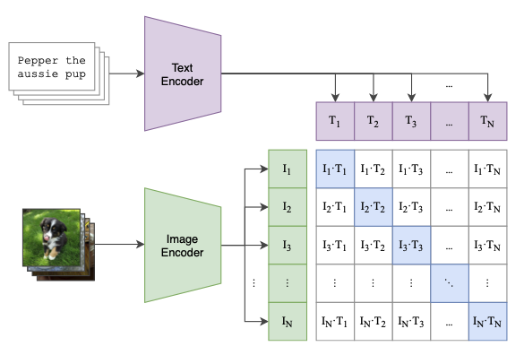
Problem Statement
Our research delves into the specific ways that CLIP, a popular multi-modal vision and language model, fails to capture intricacies in image understanding compared to humans. This project aims to identify recurring patterns in these "blind spots" by analyzing these discrepancies.

Slide 3
Motivation
It sheds light on potential biases inherent in its training data and architecture, thereby enabling targeted enhancements.
It serves as a guide for the responsible application of CLIP, pinpointing areas where it may falter in providing accurate or comprehensive representations.
Moreover, while previous research has primarily focused on testing the text encoder aspect of CLIP, such as in the paper "Mass-Producing Failures of Multimodal Systems with Language Models," we believe there is value in delving into the image embedding component of CLIP as well. By examining both parts, we can gain a more holistic understanding of CLIP's capabilities and limitations.

Slide 4
Methodology 1: Discrepancy Analysis Framework (DAF)

Slide 5
STEP 1 : Data Acquisition and Preprocessing
We initiated our analysis by leveraging the Flickr8k dataset, renowned for its diverse range of images paired with multiple captions.
To facilitate seamless processing, we meticulously pre-processed the dataset, establishing a robust mapping between image filenames and their corresponding captions
Initially, we selected the first caption for each image from the Flickr8k dataset. However, we observed that these captions often lacked sufficient description of the image content.
After sampling several images, we found that the longest caption typically provided the most comprehensive information related to the image. Consequently, we transitioned to using the longest caption for our analysis.

Slide 6
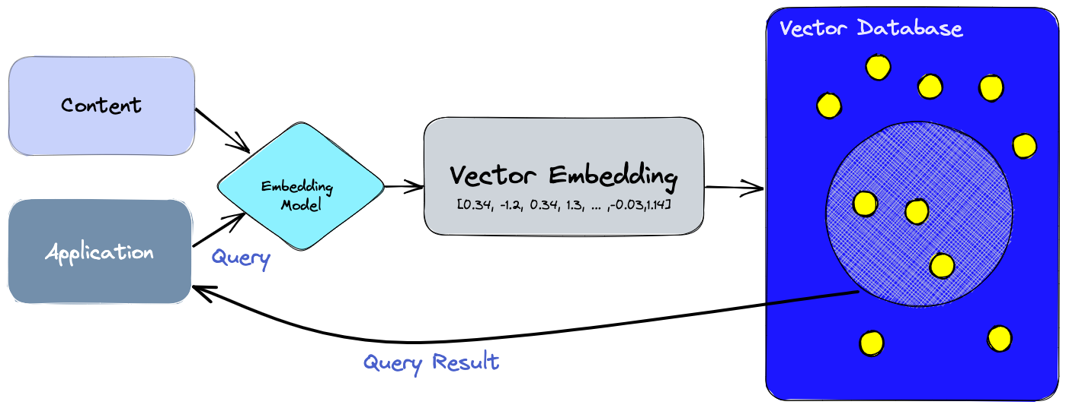
STEP 2 : Image Embedding Extraction
Harnessing the power of both CLIP and DINOv2 models, we proceeded to extract image embeddings for each image in our dataset.
These embeddings were then stored in dedicated vector databases, ensuring efficient retrieval and comparison in subsequent stages

Slide 7
STEP 3 : Comparative Examination of CLIP and DINOv2 Similarity Rankings
Utilized mathematical techniques such as L2-similarity computations initially.
Retrieved the top 10 most similar images based on the embeddings generated by CLIP and DINOv2, respectively
Pinpointed "failure" cases where the models exhibited differing similarity assessments.
Transitioned to using cosine similarity instead of L2 based on findings from various research papers, as it was deemed more accurate.

Slide 8

STEP 4:
Leveraged the advanced language processing capabilities of GPT-3.5 to conduct a nuanced analysis of these captions.
Passed caption differences to ChatGPT using a prompt to identify prominent issues.
Aiming to gain deeper insights into potential factors influencing model behavior and decision-making processes.
This Photo by Unknown author is licensed under CC BY-SA.

Slide 9
ChatGPT Prompt
I will provide a series of data for you to remember. Please memorize this data because I will ask you questions on them afterwards:
Data format: The first sentence is the main caption of the image, and the subsequent sentences are the captions generated by an embedding model on the same image.
Task: I am trying to find failures with an embedding model. The above are sentences of image captions that it encodes very similarly, even though they are conveying different concepts. Using these specific examples, are there any general types of failures you notice the embedding is making, or any common features that the embedding fails to encode? Try to give failures that are specific enough that someone could reliably produce examples that the embedding would encode similarly, even though it shouldn’t. Please try to give as many general failures as possible, and please just state each failure without further explanation. Please focus on differences that are important visually, as these embeddings are later used to generate images or videos.
Here is an example for the format: {{"'Failure Type Heading'": "'Description: Describe in few words as to why the failure occurred'"}}
Give the output as Python Dictionary of objects

Slide 10
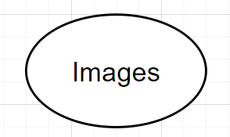
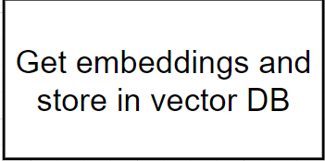
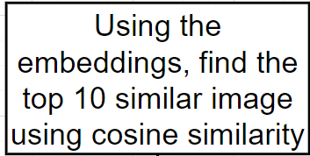
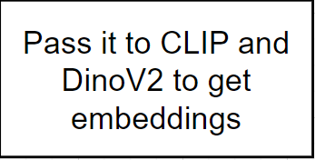
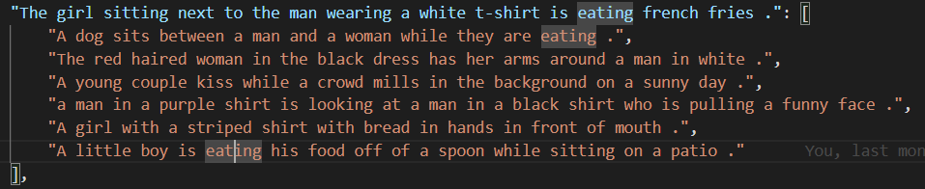
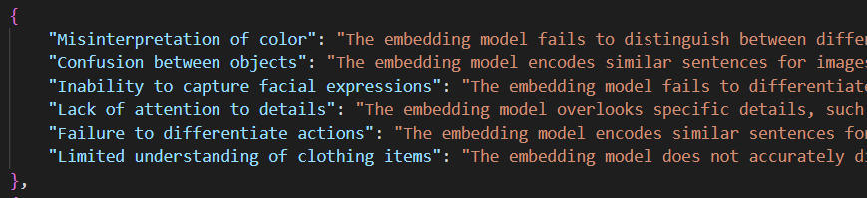
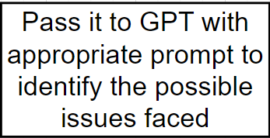
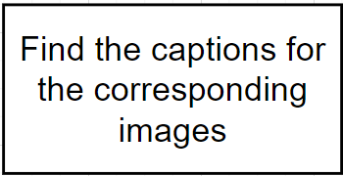
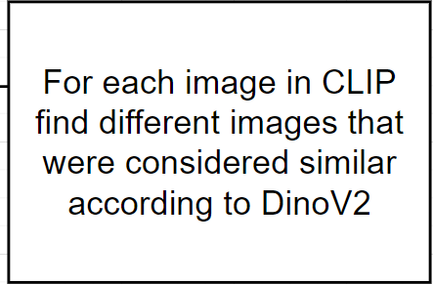
Overview of Discrepancy Analysis Framework

Slide 11
Limitation of DAF
Dataset Consistency: The effectiveness of the analysis heavily relies on the dataset containing similar images. If the dataset lacks diversity or doesn't cover various scenarios adequately, the similarity between captions may not reflect actual model failures.
Descriptive Captions: The quality and descriptiveness of captions play a crucial role in identifying model failures. If captions are vague or insufficient in describing the content of images, the identified similarities may not accurately represent model limitations.

Slide 12
Methodology2: Transformative Caption Analysis for CLIP (TCAC)

Slide 13
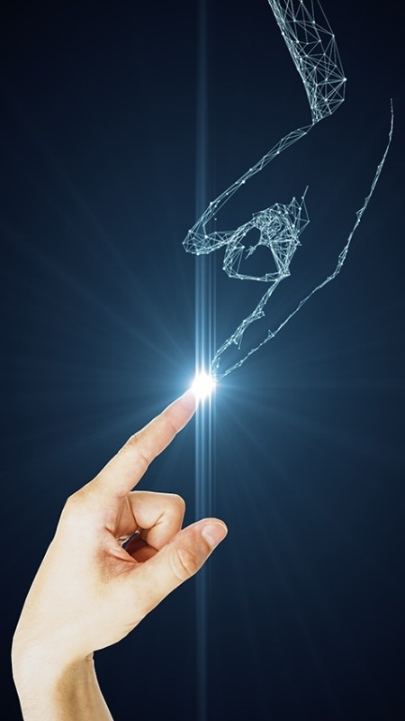
Given our interest in understanding the robustness of the CLIP image model, we propose to explore the impact of image transformations on the model's predicted captions.
Creating a Classifier to Predict Caption Probabilities for a Single Image
Objective: Assessing How Transformations Affect Predicted Caption Probabilities
Significance: Gaining Insights into CLIP's Robustness and Adaptability

Slide 14
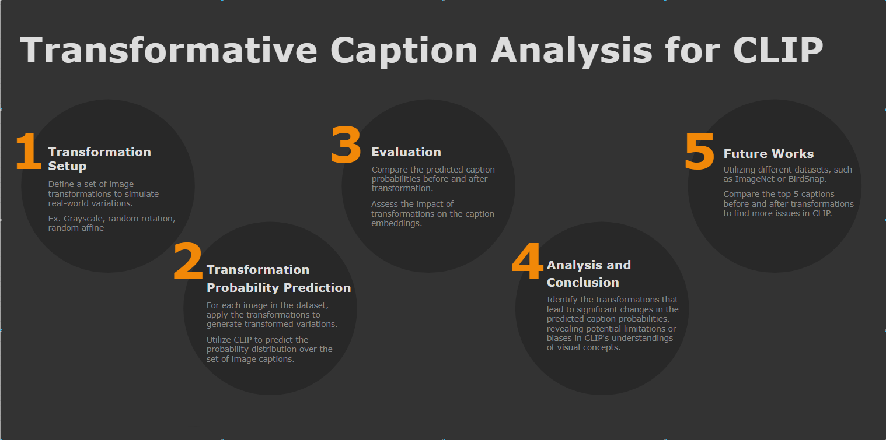

Slide 15
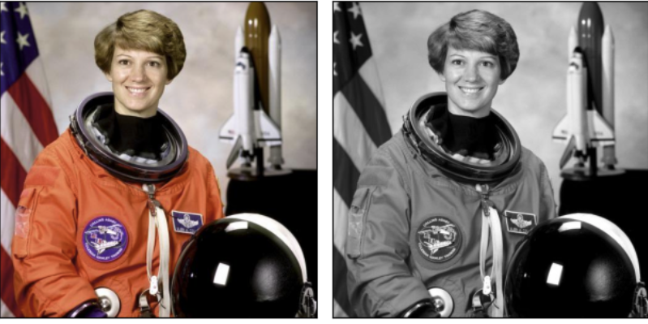
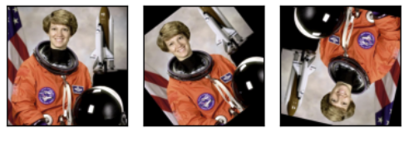
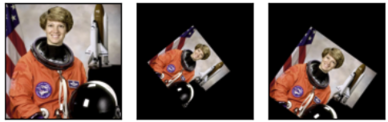
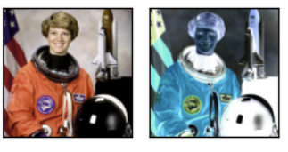
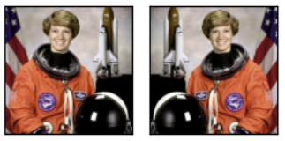
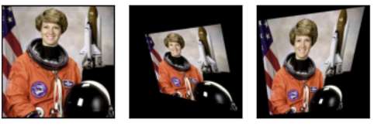
Image Transformation Setup
Grayscale
Random Rotation
Random Affine
Random Invert
Horizontal Flip
Random Perspective

Slide 16
DataSet and PreProcessing
Utilized Flicker8k dataset with 5 captions per image
Employed CLIP text embedding to find similar captions for each caption. Generated a list of 50 captions by finding 10 similar captions for each original caption. Removed duplicate captions to obtain a list of unique captions.
Predicted the probability of each unique caption for each image. Identified the top 10 captions before and after transformation
Conducted manual inspections of images and captions for evaluation
Developed a custom class to reduce search space and hold image name, original top 10 captions, transformed top 10 captions, and the difference in caption count. Sorted the list of class according to caption count difference.
Analyzed 100 such classes for each transformation type.

Slide 17
Evaluation Process
For each image in the dataset, apply the defined transformations to generate transformed versions of the image.
Utilize CLIP to predict the probability distribution over the set of captions associated with each transformed image
Compare the predicted caption probabilities before and after transformation for each image
Identify transformations that lead to significant changes in the predicted caption probabilities.
Explore cases where transformed images result in disparate predictions compared to the original image

Slide 18
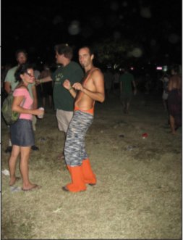
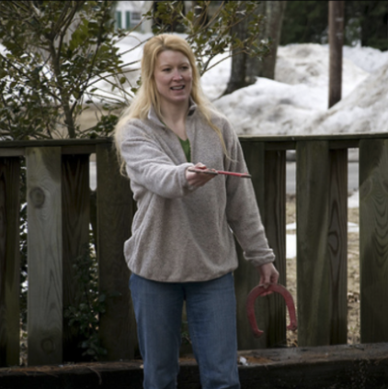
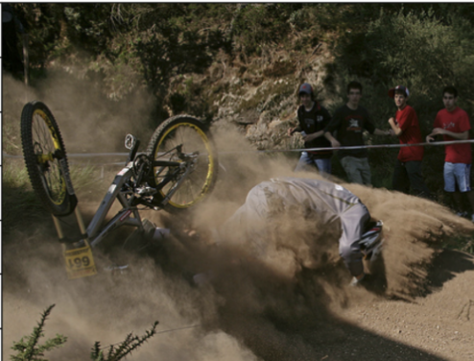
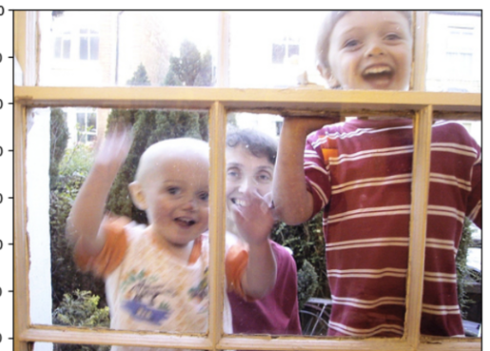
Combined Evaluation Results
Misinterpretation of color
"A girl in orange shirt and clown makeup stands in a park while others look on"
"A man with orange boots stands with a few other people "
Confusion between objects
“A woman smoking a cigarette outside in the snow .”
“Woman standing outside holding a horseshoe in each hand"
Lack of attention to details
“A dirt biker with number 625 is racing on a course “
but the original caption “Bike racer number 661 wrecks on dirt racetrack” was not in top 10 captions
Different activities and positions of people not being encoded properly
One little boy is standing inside a house on one side of a window while another boy is outside squirting the window with a hose “
“Two young children , one wearing a red striped shirt , are looking in through the window while an adult in a pink shirt watches from behind”

Slide 19
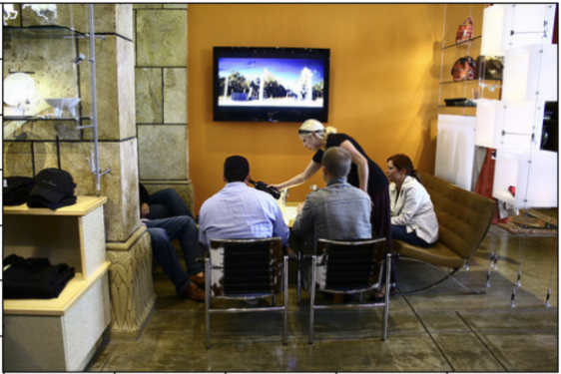
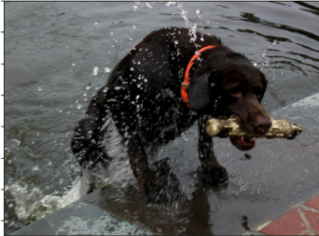
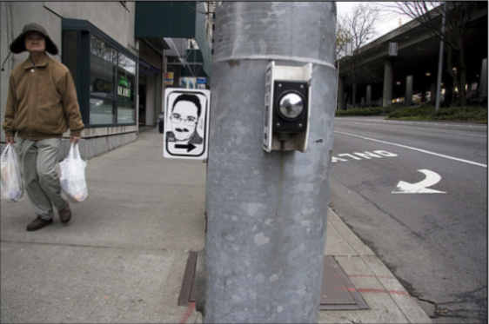
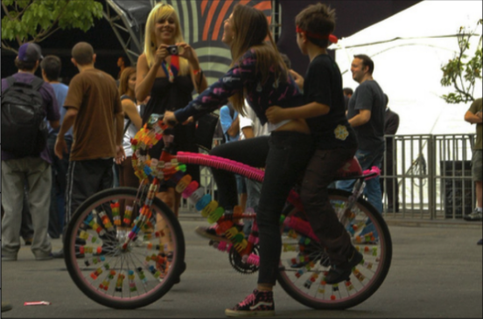
Combined Evaluation Results
Failure to account for the size and number of objects/ person / animals present in the image
"A person sits on the floor and eats in front of a television"
"Five people are sitting in a bar , while a tv plays nearby ."
Confusion between objects
"A black dog runs through the water with a ball in its mouth.“
"A black dog with a brown muzzle next to a body of water , shaking off water with a stick in its mouth ."
Disregarding object interactions
“ A man is walking down the street holding up a picture .”
“ A man carries two grocery bags , a sign of a funny man is by the pole near him .”
Different types of transportation/animal confusion
“ A woman wearing a pink sweater rides a bike with a car behind her “
“a brightly decorated bicycle with cart with people walking around in the background"

Slide 20
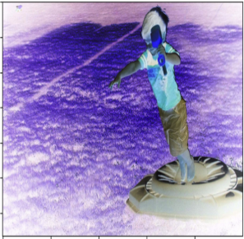
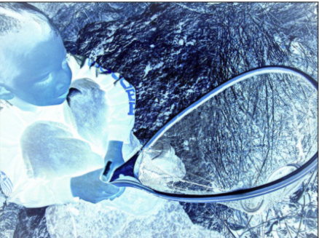
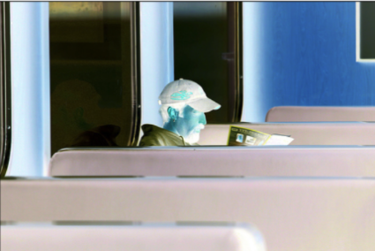
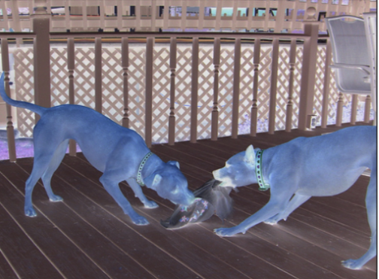
Transformation Based Result - Random Invert
Failure to capture the difference in gender roles and activities
“ An elderly woman is sitting by a window reading”
“ A man sits by a window on a train “ and “A bearded man sits at a bus window .”
Different types of transportation/animal confusion
“ A dog and a cat are playing on a wooden floor .”
“Two dogs are playing together and fighting over a toy”
Failure to account for the size and number of objects/ person / animals present in the image
"A boy jumps over another boy on a trampoline .”
“A young boy in a red uniform jumps on a trampoline .”
Lack of attention to details and Inability to Capture Age
The tennis player holds his racket in preparation for the ball
" A boy holds a net with a snake in it close to the ground” was not even in top 10 which was 1st before transformation

Slide 21
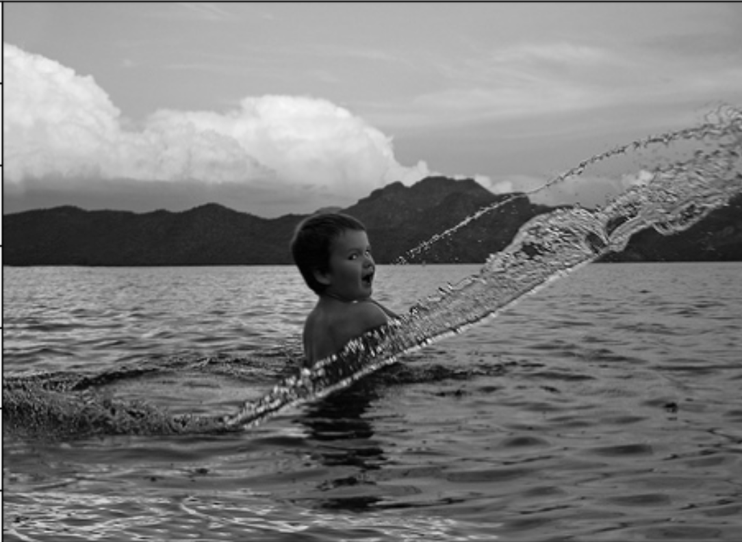
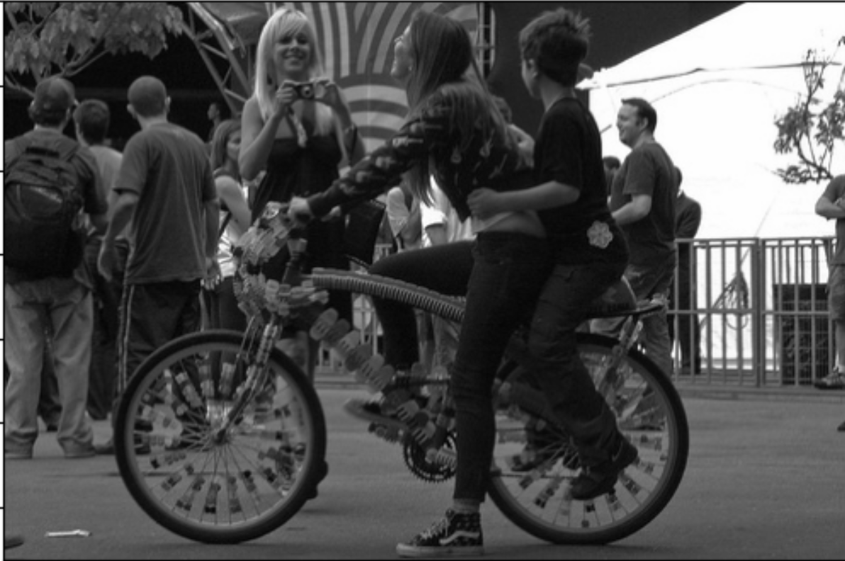
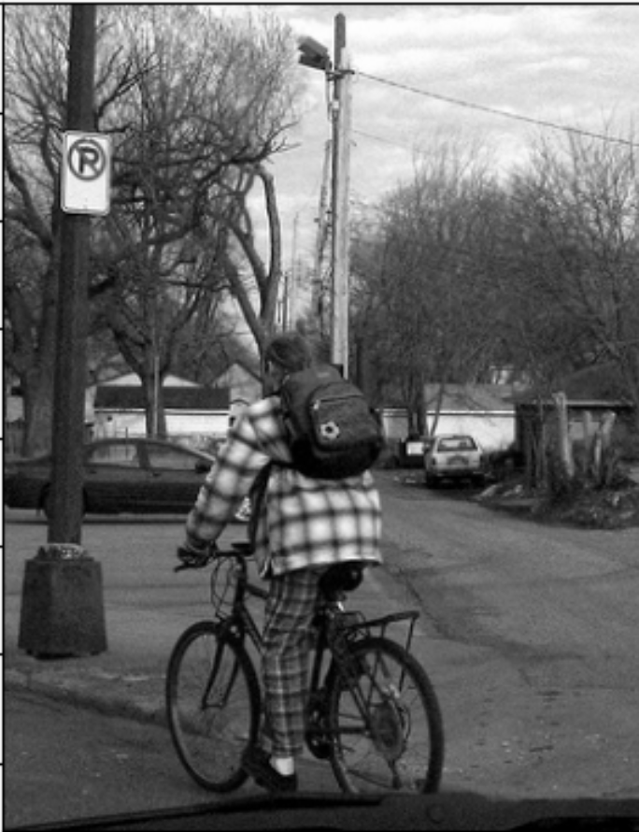
Transformation Based Result - Grayscale
Failure to capture the difference in gender roles and activities
“ An elderly woman is sitting by a window reading”
“ A man sits by a window on a train “ and “A bearded man sits at a bus window .”
Different activities and positions of people not being encoded properly
'A man is helping a girl sit on a large bicycle .', 'A man and woman ride bicycles next to each other ‘
"A girl sits on a decorated bike with a younger boy while another girl takes a picture ." - not even in top 5 although was 1st before
Confusion between clothes/gender
"Girl in plaid shirt riding a unicycle ."
” A person wearing a blue and white coat rides a bicycle down the street”

Slide 22
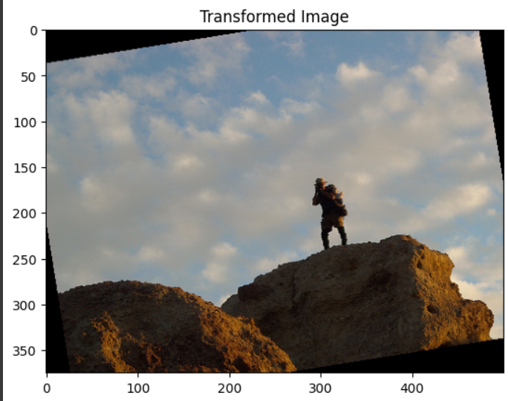
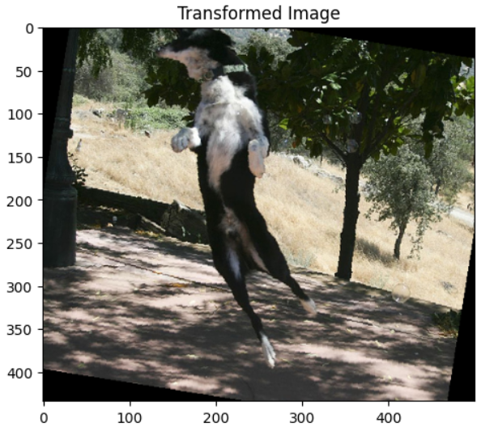
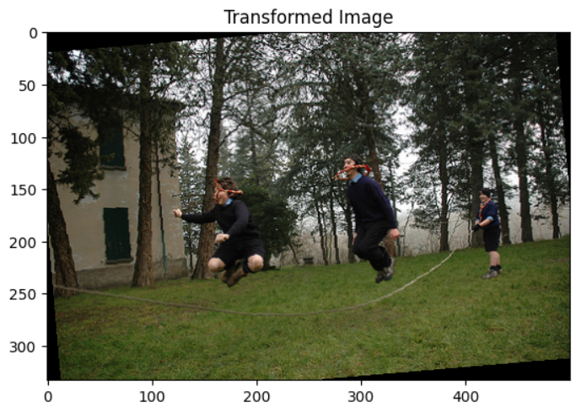
Transformation Based Result – Random Rotation
Failure to capture the difference in gender roles and activities
"A person stands on the top of a cliff as other attempts to climb it ."
"A man stands on top of a rocky hill ."
Different types of transportation/animal confusion
"A dog chases another by a tree .“
"A black and white dog leaping to catch an orange ball in an open field ."
Failure to account for the size and number of objects/ person / animals present in the image
"Three children wearing soccer uniforms chase after a blue and grey soccer ball ."
"Three people playing jump rope in a field .“

Slide 23
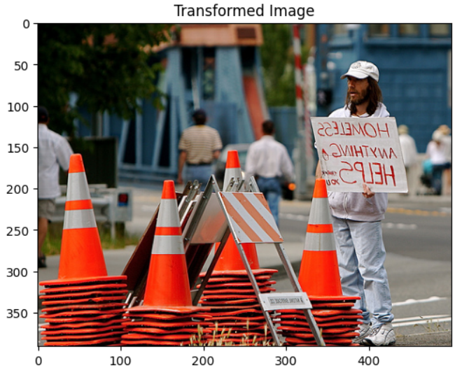
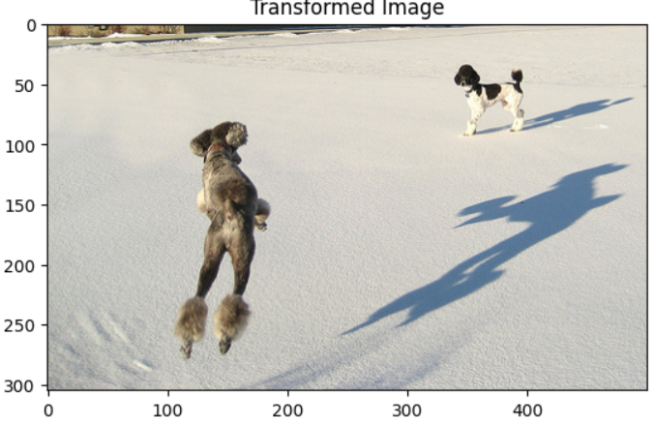
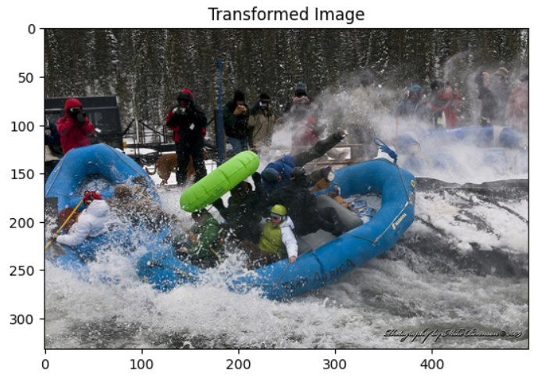
Transformation Based Result – Horizontal Flip
Lack of attention to details
“A man in a yellow hi-viz jacket is standing beside and orange sign .",
"A man holds a sign reading \" HOMELESS ANYTHING HELPS \" near a construction site .“ – this comes 5th priority in the transformed captions
Failure to account for the size and number of objects/ person / animals present in the image
"Three dogs jump , run and play in the snowy landscape .“
"A grey dog is jumping toward a black and white dog in the snow ."
Failure to capture the difference in gender roles and activities
"A group of men in an inner tube going over some rapids“
"People are tossed around in a blue raft in a foamy river ."

Slide 24
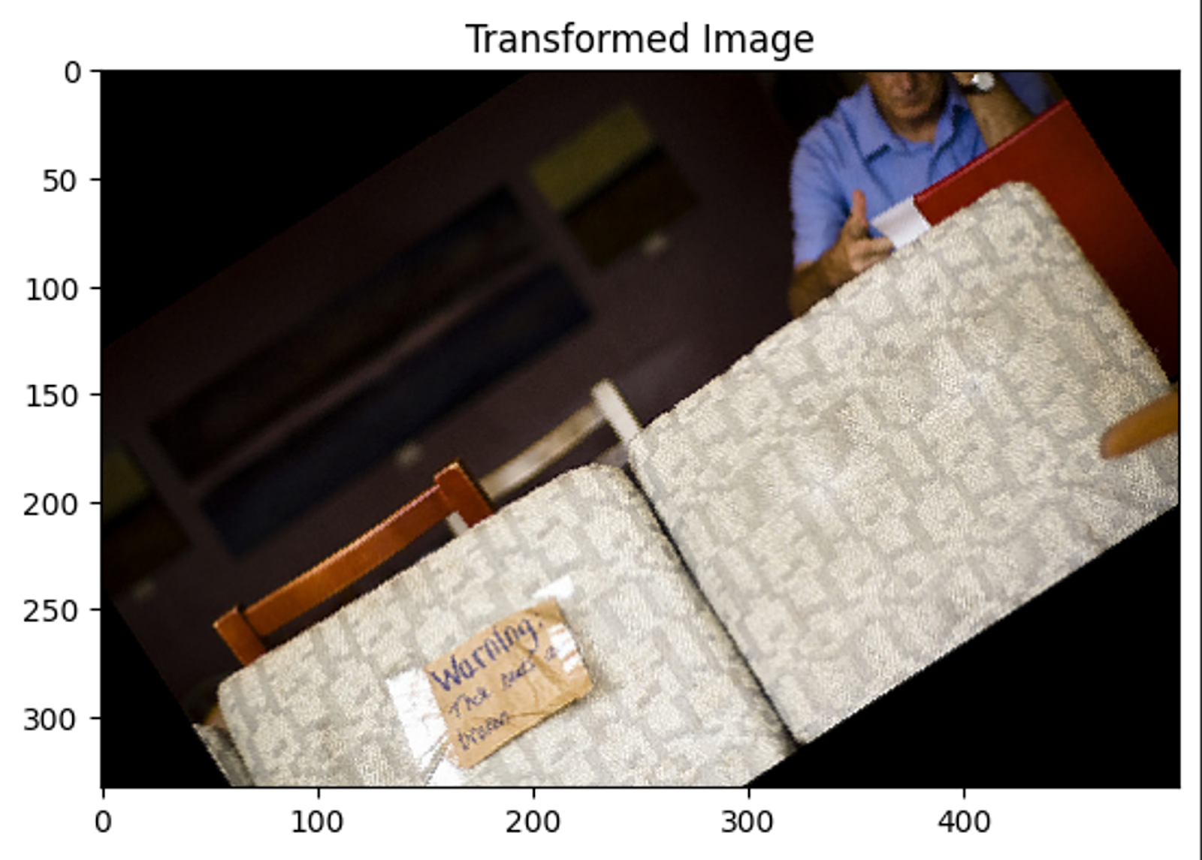
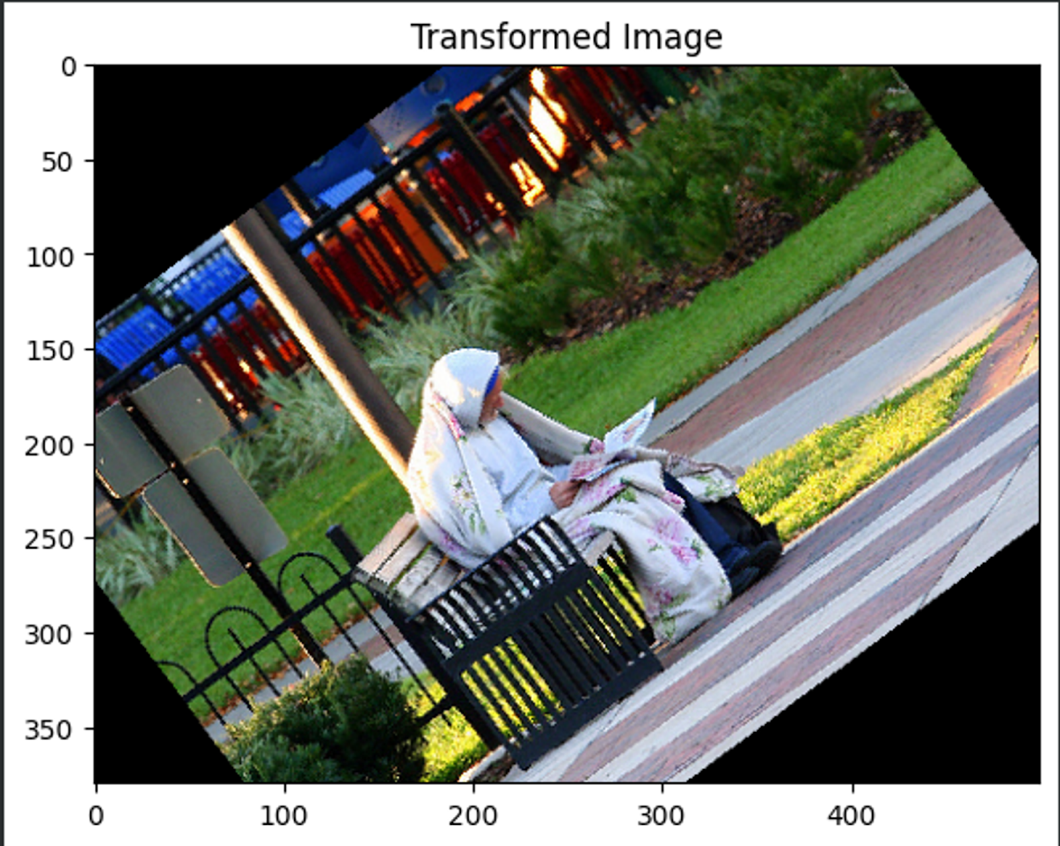
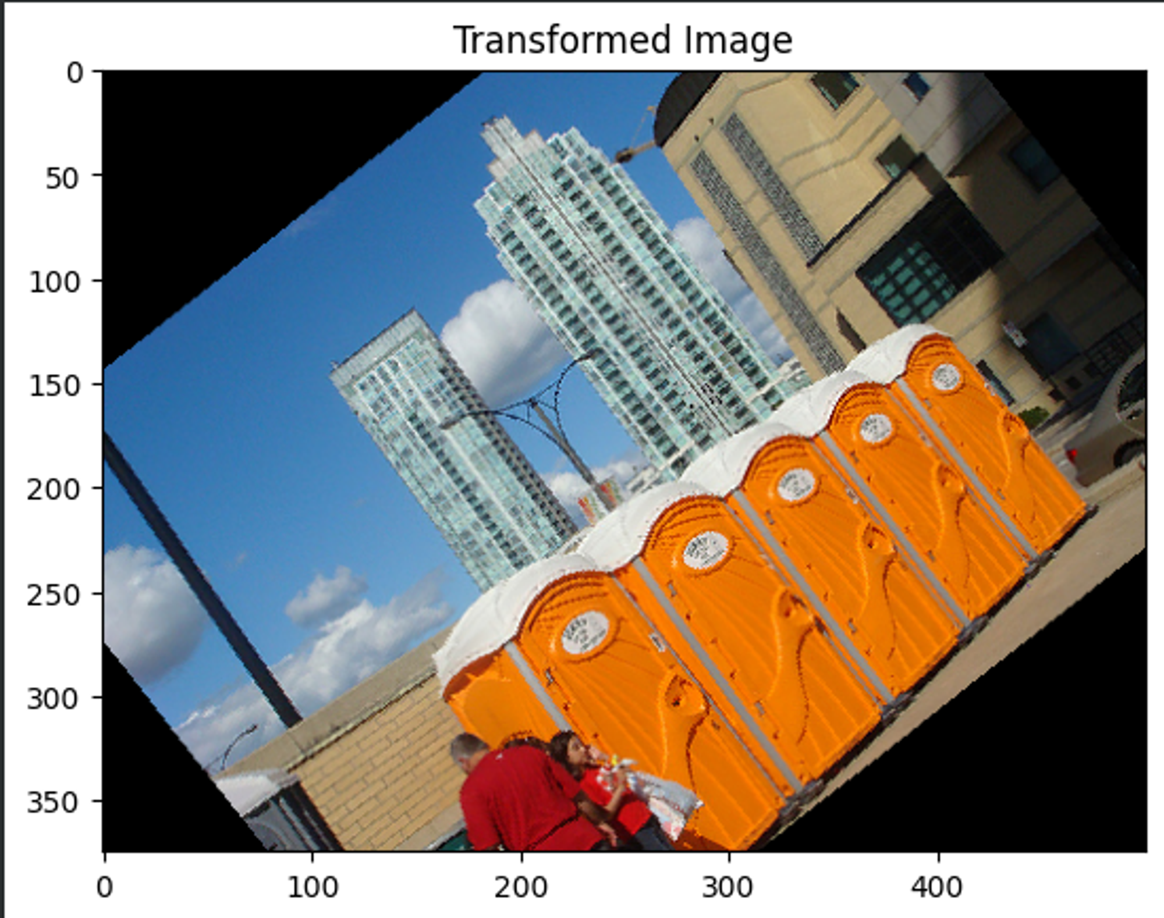
Transformation Based Result – Random Affine
Lack of attention to details
"A man drinking and reading the paper."
"A couch sits broken while a man sits at a table behind them."
Cultural misrepresentation
"A middle eastern man in a white robe is sitting on a wooden bench with his shoes."
"A woman reads a paper on a bench in a park ."
Confusion between objects
"A man walking in a brush with a big orange backpack."
"A family waits next to some portable toilets in the city."

Slide 25
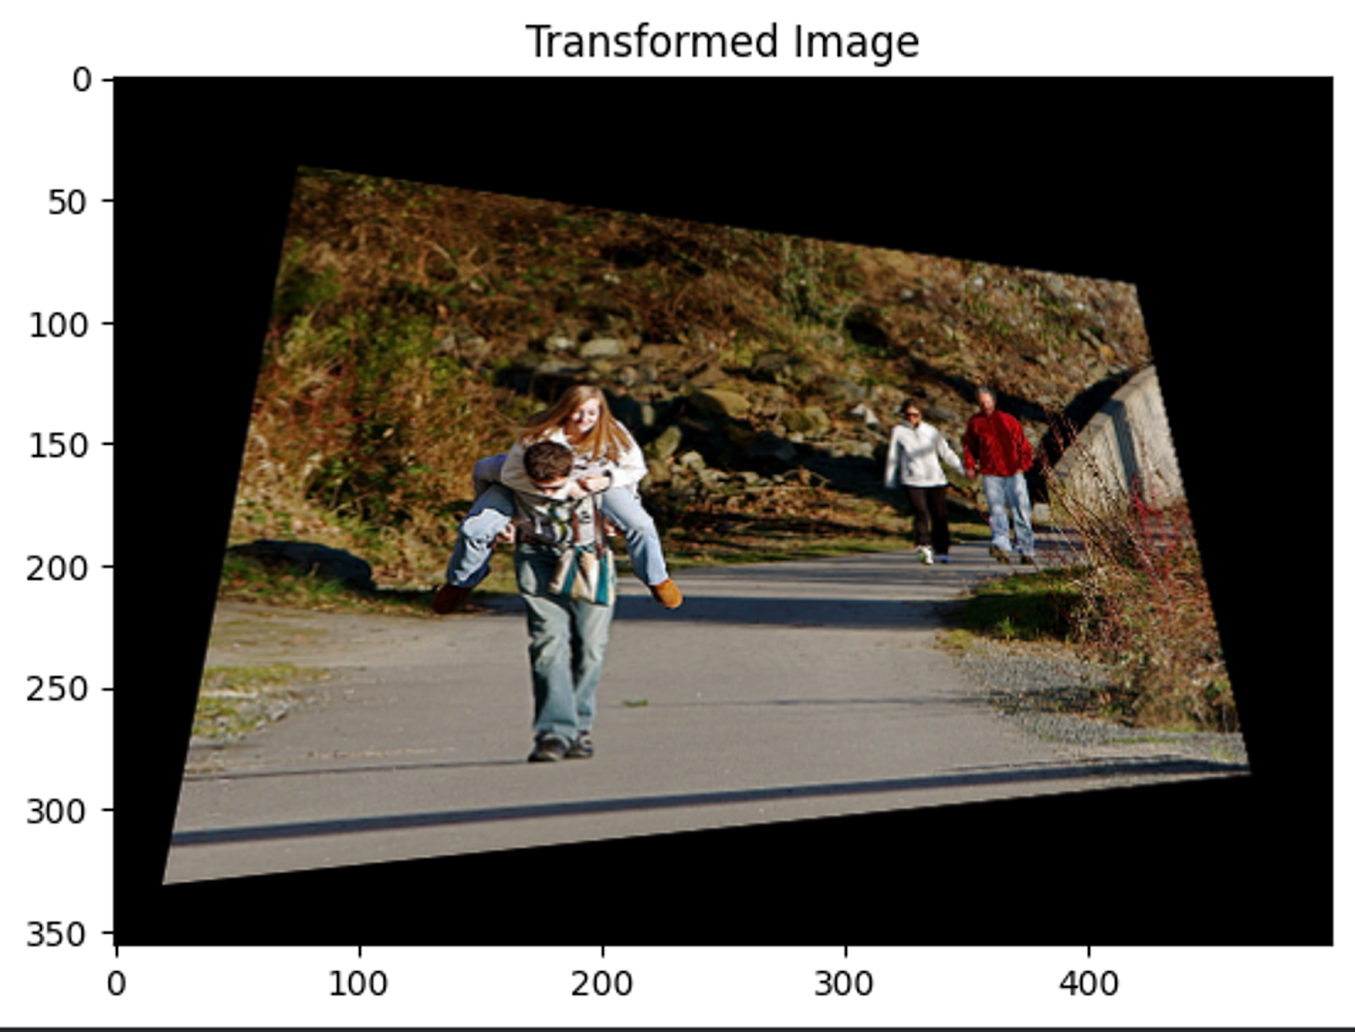
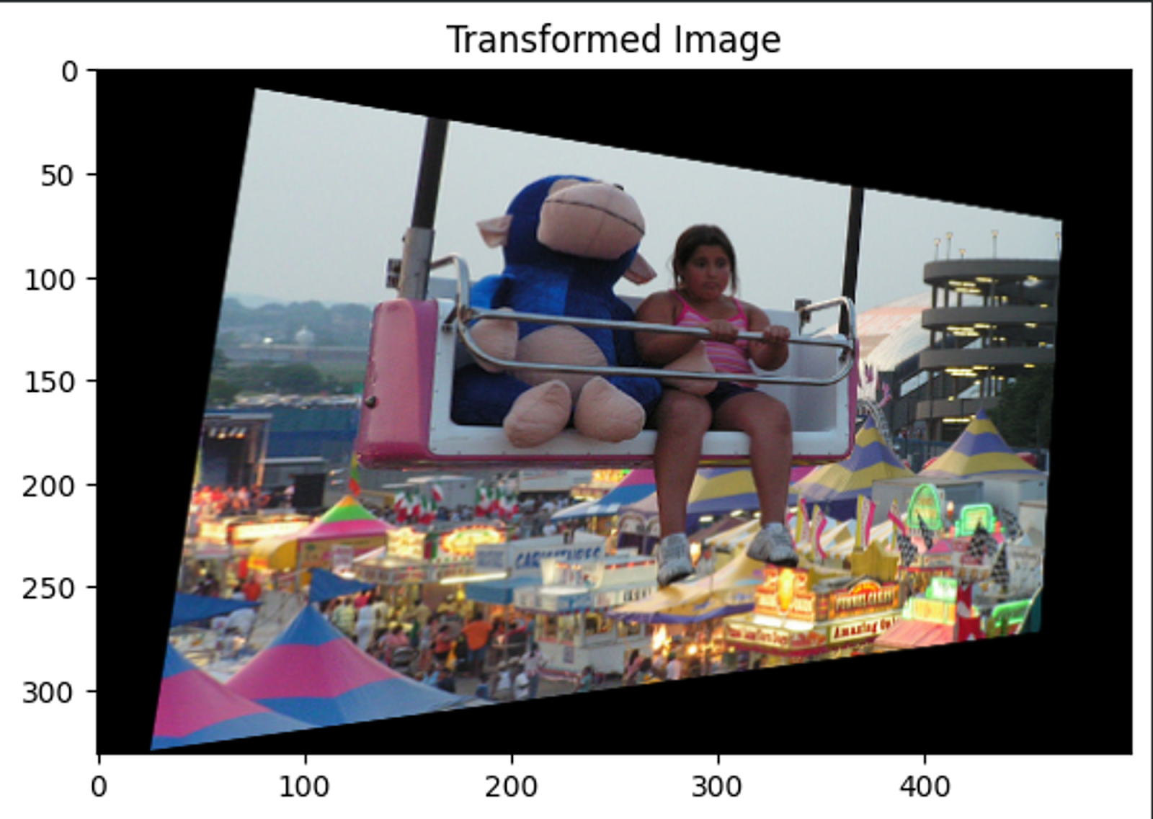
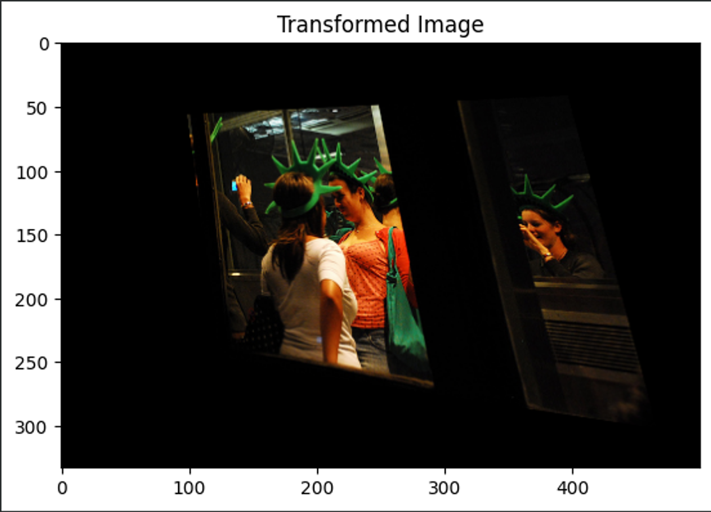
Transformation Based Result – Random Perspective
Confusion between objects
“Two girls with ponytails ride an amusement park ride .",
"A little girl sits on a Farris wheel seat next to a giant stuffed animal."
Misattribution of geographic context
"Some young people take photos of each other while in New York."
"Three women with statue of liberty hats and taking a picture."
Hallucination of water-like features
"Child, man, and woman walking near the water."
"Several people are walking down a trail."
(Not the most descriptive, but doesn't hallucinate water.)

Slide 26

14 Systematical Failures
Misinterpretation of color
Confusion between objects
Inability to capture facial expressions
Lack of attention to details
Different activities and positions of people not being encoded properly
Failure to account for the size and number of objects/ person / animals present in the image
Failure to capture the difference in gender roles and activities
Cultural Misrepresentation
Action vs. Stillness confusion
Failure to identify the direction of movement or positioning of objects in the image
Disregarding object interactions
Different types of transportation/animal confusion
Hallucination of Water-like Features
Misattribution of Geographic Context

Slide 27
Limitations/ Future Scope
Subjectivity in Evaluation: Manual assessment of the impact of transformations on predicted captions may introduce subjectivity and bias, potentially leading to inconsistent evaluations. So, there is a need to automate this process as well.
The effectiveness of transformations in revealing CLIP's limitations may vary depending on the dataset used, limiting the generalizability of findings. So, need for evaluation of multiple dataset are required.

Slide 28
Thank You !!!

